Slide 1
Project Swasthya: An Early-Warning System for Environmental Health
Bridging the gap between pollution and public health through data-driven intelligence.

Slide 2
Gelasio

Slide 3
Objectives
Current public health systems face three fundamental challenges that prevent effective environmental health management:
No Hyper-Local Data
No Real-Time Health Tracking
Reactive Rather Than Proactive
Pollution monitoring lacks granularity. Officials cannot track PM2.5 and NO₂ levels at neighbourhood scale, leaving vulnerable communities unprotected.
Community health data arrives too late. By the time patterns emerge, the damage is already done to public health.
Officials respond after crises emerge. Without predictive intelligence, prevention remains impossible and resources are wasted on emergency responses.

Slide 4
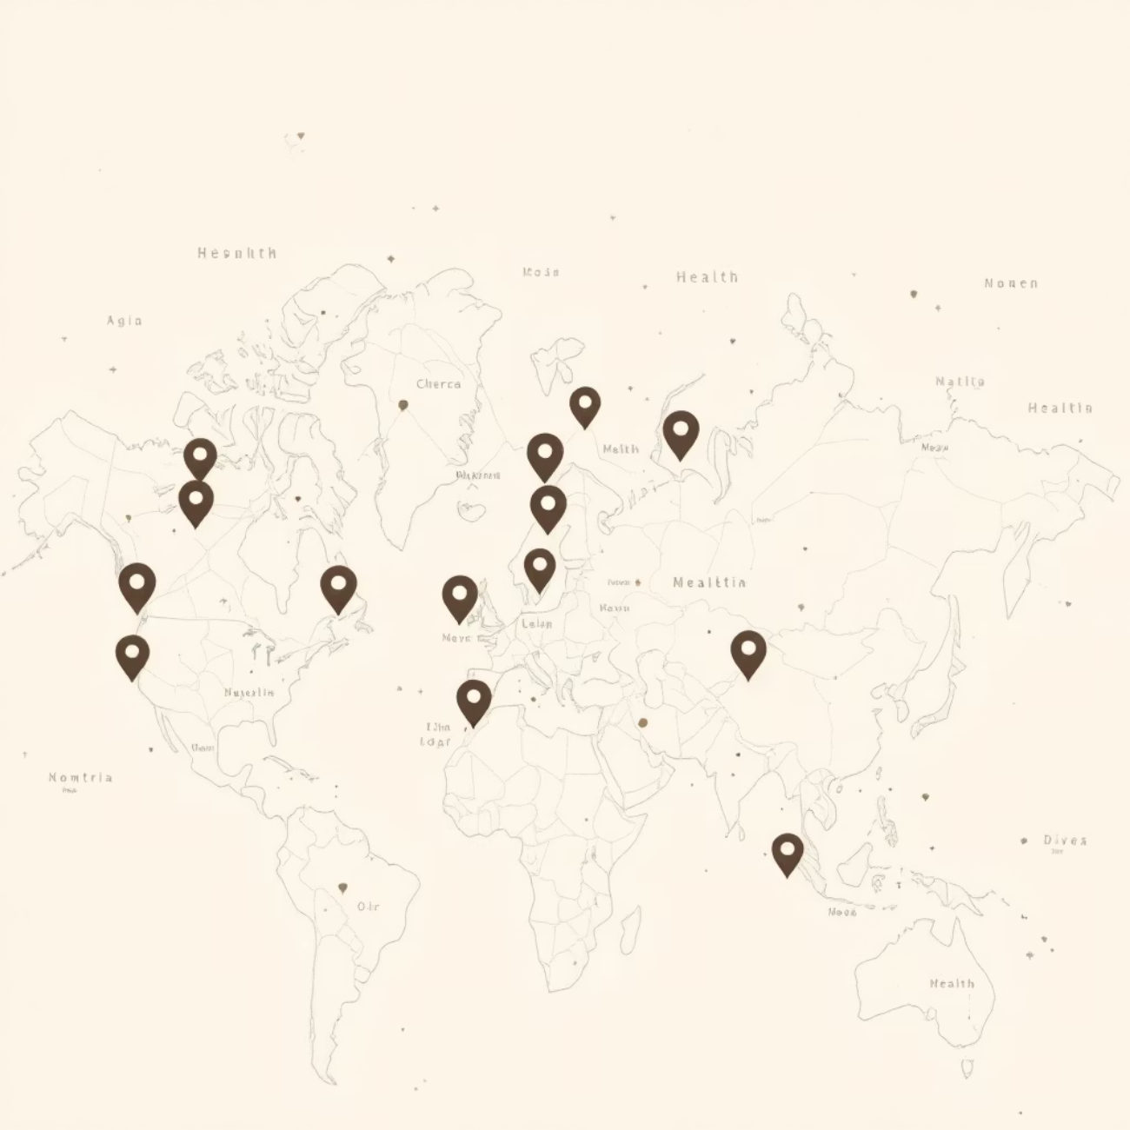
Our Vision: From Reaction to Prevention
Mission Statement
Build a privacy-first, scalable early-warning system that links pollution and health data in real time, transforming how communities protect public health.
Primary Goal
Deliver actionable, map-based intelligence to empower proactive public health decisions before crises develop.
"Empowering communities to prevent health crises rather than merely responding to them."

Slide 5




Meet the Project Swasthya Team
Ashpak Sheikh
Mayur Patil
Deep Learning & Data Engineering
IoT & Cloud Infrastructure
Rohan Pawar
Sarthak Zunjurke
Full-Stack Development (Dashboard & APIs)
Full-Stack Development (Citizen PWA & Clinic Portal)

Slide 6
Hybrid Data Strategy: Three-Pronged Approach
Project Swasthya collects environmental and health data through three complementary channels, ensuring comprehensive coverage whilst maintaining data quality and privacy:
01
02
03
IoT Sensor Network
Clinic Portal Integration
Citizen PWA Reporting
ESP32-based sensors deployed across the city collect hyper-local air pollution data (PM2.5, NO₂, temperature, humidity) every 15 minutes, creating unprecedented spatial resolution.
Healthcare facilities upload aggregated, anonymised health statistics through a secure portal, providing professional medical insights without compromising patient confidentiality.
Individuals report symptoms securely through our Progressive Web App using privacy-preserving Federated Learning, enabling community-scale health monitoring without data exposure.

Slide 7





Core Innovation: Federated Learning
The Privacy Challenge
Traditional health monitoring requires collecting sensitive personal data, creating privacy risks and limiting participation. How can we leverage citizen health data without violating privacy rights?
Our Solution
Federated Learning (FL) — a revolutionary approach that trains AI models without ever accessing raw user data.
Model Distribution
Local Training
Secure Updates
Central server sends AI model to citizen smartphones
Model learns from user data entirely on device — data never leaves phone
Only encrypted model improvements shared back to server
Result: 100% user privacy guaranteed whilst enabling powerful community health insights.

Slide 8




System Architecture: Four-Layer Design
Project Swasthya employs a scalable, cloud-native architecture designed for real-time data processing and AI-driven analysis:
Ingestion Layer (AWS)
Data Sources Layer
AWS IoT Core, Kinesis, and Lambda functions handle real-time data ingestion, validation, and initial processing at scale.
IoT sensors, external APIs, Citizen PWA, and clinic portals continuously feed diverse data streams into the system.
Presentation Layer
AI & Storage Layer
React-based dashboard for officials and PWA for citizens provide intuitive access to insights, alerts, and reporting capabilities.
SageMaker trains models, whilst RDS, Timestream, and Flower FL server manage structured data, time-series, and federated learning coordination.

Slide 9

AI Engine & Technology Stack
Hybrid AI System
Technology Stack
Client-Side Intelligence: TensorFlow.js runs on smartphones, learning personal symptom patterns whilst preserving complete privacy.
Frontend: React, Progressive Web App
Backend: Node.js, Express.js
Server-Side Analysis: Graph Transformer models running on AWS SageMaker identify city-wide correlations between pollution exposure and health outcomes.
Cloud: AWS (IoT Core, Lambda, SageMaker)
AI/ML: TensorFlow.js, Graph Transformers, Flower
Hardware: ESP32 microcontrollers
This dual approach combines individual pattern recognition with population-level intelligence, creating a comprehensive early-warning system.
Database: RDS, Timestream

Slide 10
Applications & Development Roadmap
For Citizens
Development Phases
View live air quality data for their neighbourhood
Research & Architecture
1
Report symptoms securely through privacy-protected app
Receive personalised health alerts based on pollution levels
Completed
Contribute to community health without data exposure
2
Core Implementation
For Public Health Officials
Access real-time correlation alerts between pollution and health
In Progress
AI Model & Integration
3
Visualise hotspot maps identifying at-risk areas
Make data-driven intervention decisions
Next Phase
Track effectiveness of environmental policies
4
Beta Testing & Final Report
Upcoming

Slide 11



Transforming Public Health Through Data
Project Swasthya represents a paradigm shift in environmental health monitoring, creating value for multiple stakeholders whilst maintaining the highest privacy standards.
Public Health Officials
Citizens
Researchers
Shift from reactive crisis management to proactive, data-driven prevention strategies with real-time intelligence.
Contribute securely to community health protection whilst receiving personalised environmental health guidance.
Access unprecedented high-resolution environmental health dataset for advancing scientific understanding.
Thank you.

